Slide 1

Healthcare Industry Heart Disease - 2020 annual CDC survey data
Predictive Analysis

Slide 2

objective
Our objective is to understand the factors which have a significant effect on the likelihood of heart disease and also to predict if one person has heart disease or not with his or her health condition.

Slide 3
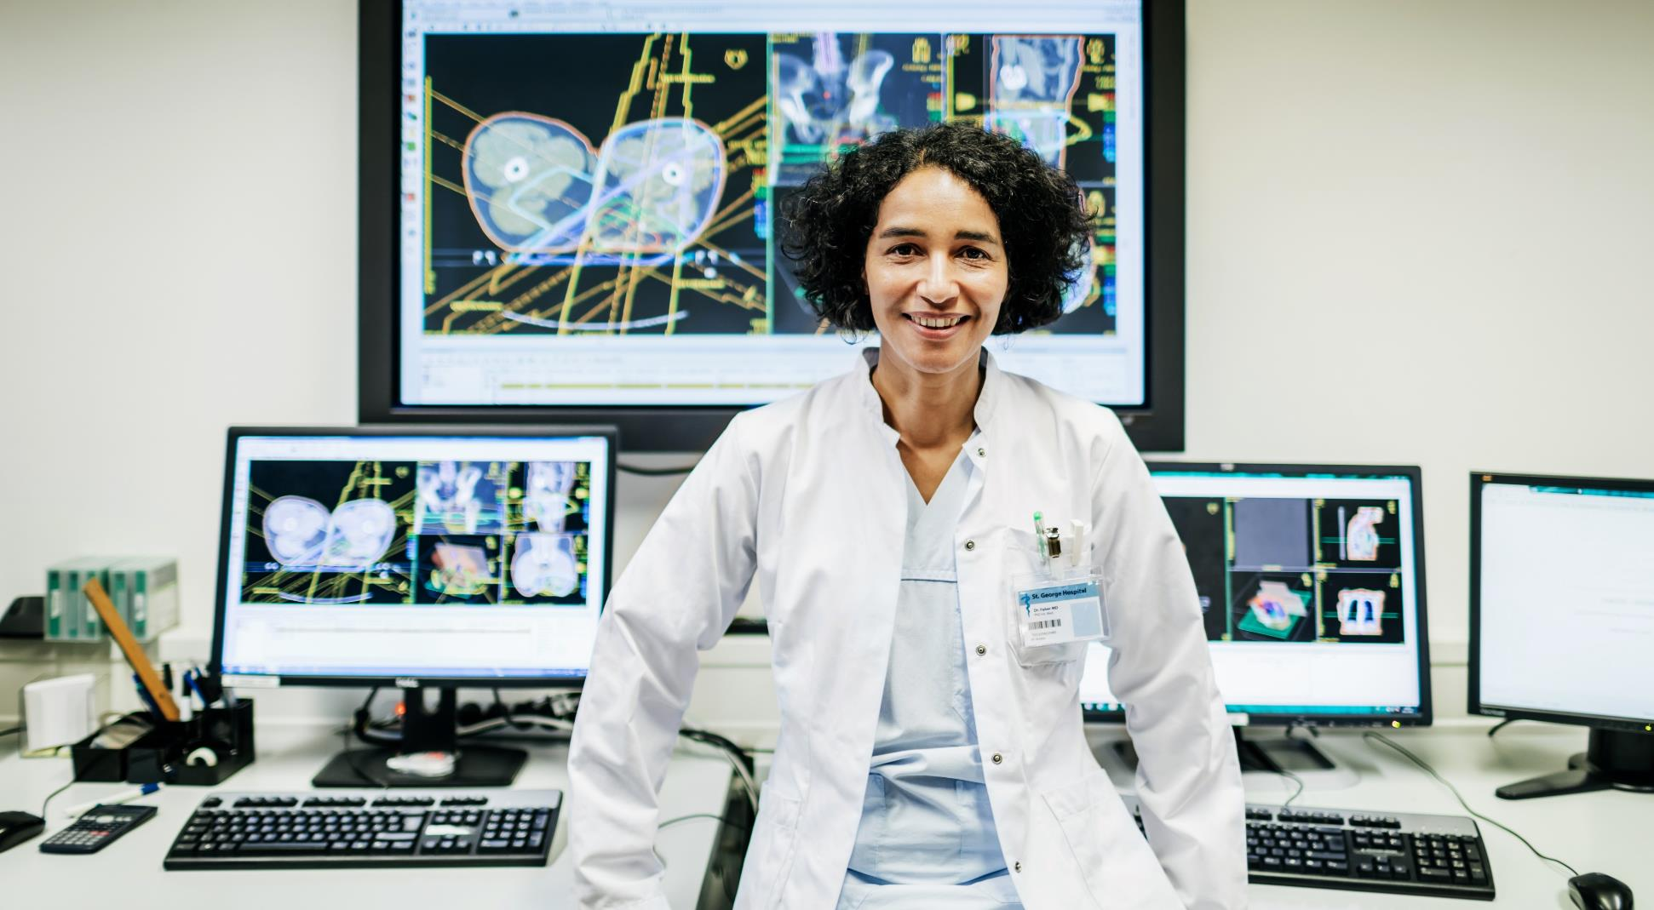





agenda
Dataset Outlook
Exploratory Data Analysis
Model selection and Comparison
Variable Description
Structure and Summary details
Cleansing and Data Pre-processing
Pie graphs
Scatter Plots
Histograms
Logistic Regression
SVM – Support Vector Machines
XGBoost
Random Forest
Interpretations and Recommendations
Q & A
Model exploration and analysis
Suggestions
Question and Answers

Slide 4
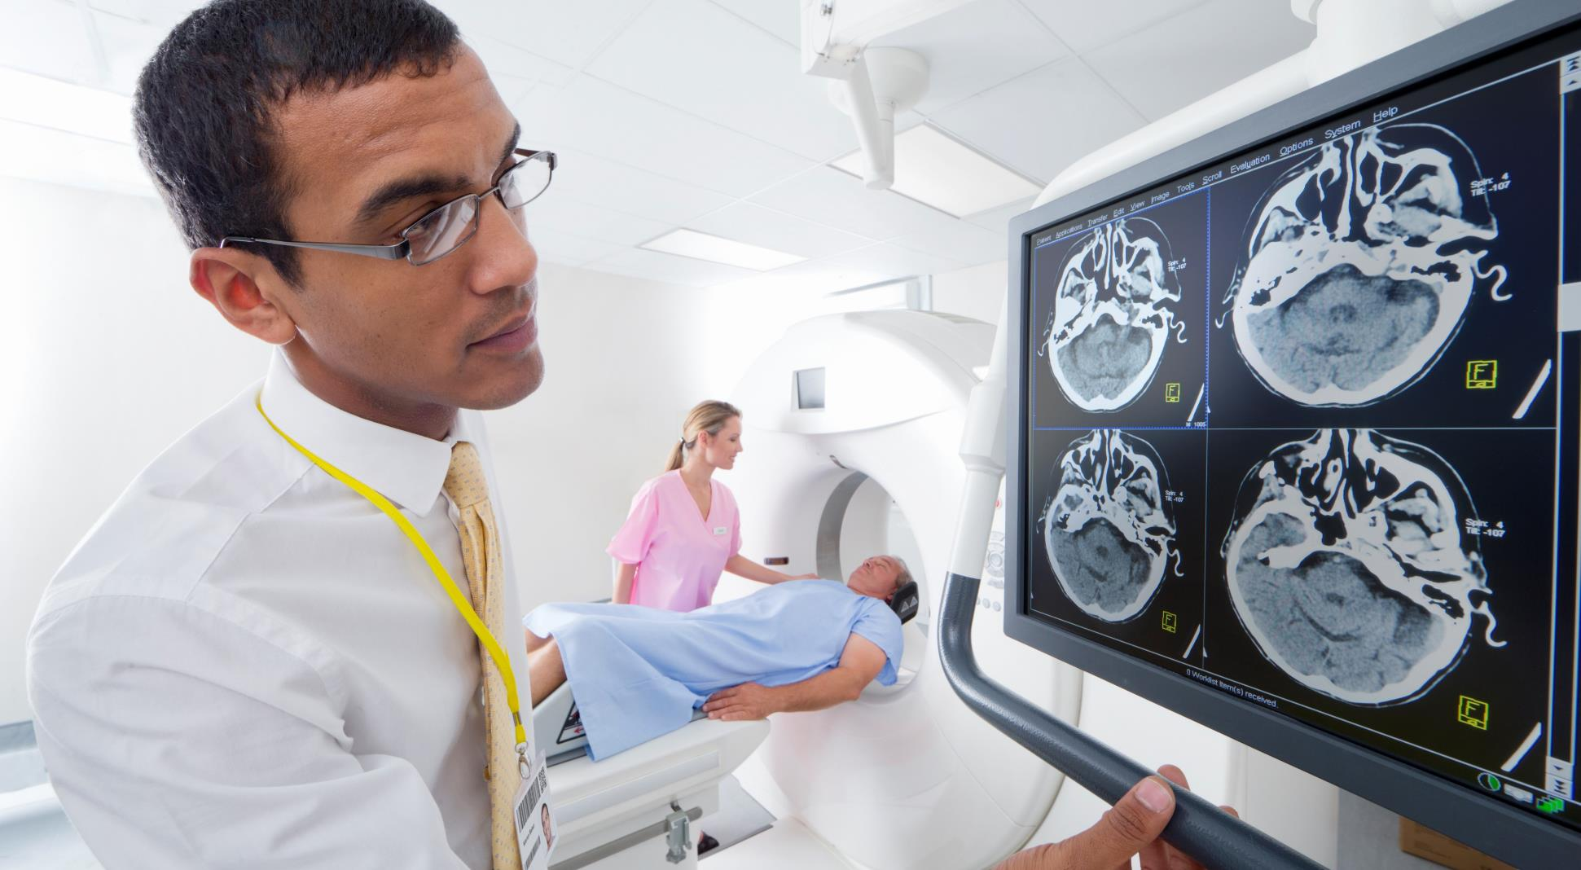



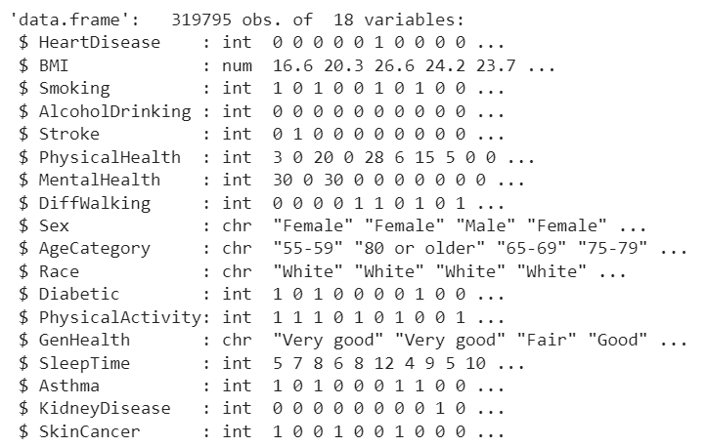
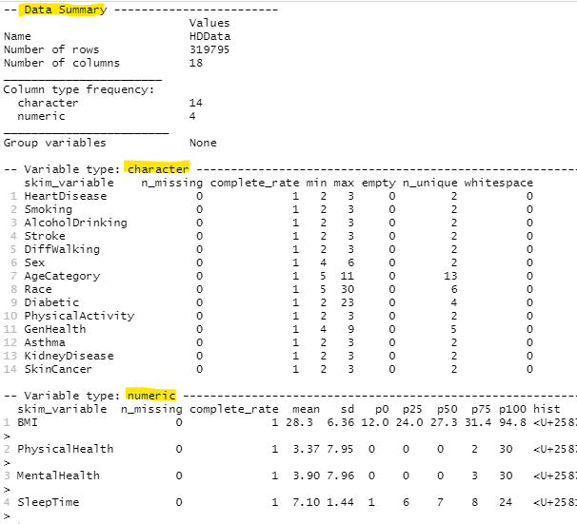
dataset outlook
annual CDC survey data
Structural details
Data summary details
The dataset is appeared to be updated. (2020 –2022)
Converted all categorical data to factors,
Numerical variables are sleep time, physical health, mental health, and BMI values.
Eliminated missing values (4)

Slide 5
Exploratory data analysis [1 of 3]
PIE GRAPHS
Smoking
Stroke
Alcohol Drinking
Physical Activities
Gender
 | Has heart disease = Yes | GROWTH | Has heart disease = No | YR 3
Factors | No | Yes | No | Yes
Smoking | 11336 | 16037 | 176551 | 115871
Stroke | 22984 | 4389 | 284742 | 7680
Alcohol Drinking | 26232 | 1141 | 271786 | 20636
Physical Activities | 9884 | 17489 | 61954 | 230468
 | Female | Male | Female | Male
Gender | 11234 | 16139 | 156571 | 135851

Slide 6
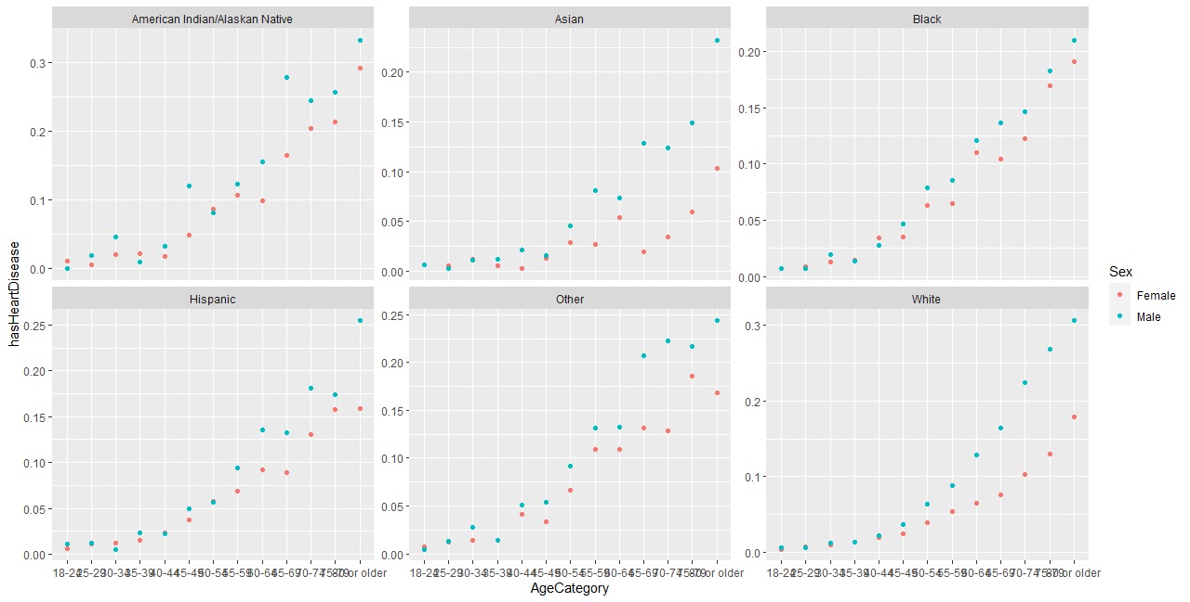
Exploratory data analysis [2 of 3]
SCATTER PLOTS
Gender and Age category wise - % of people having heart disease for each race

Slide 7
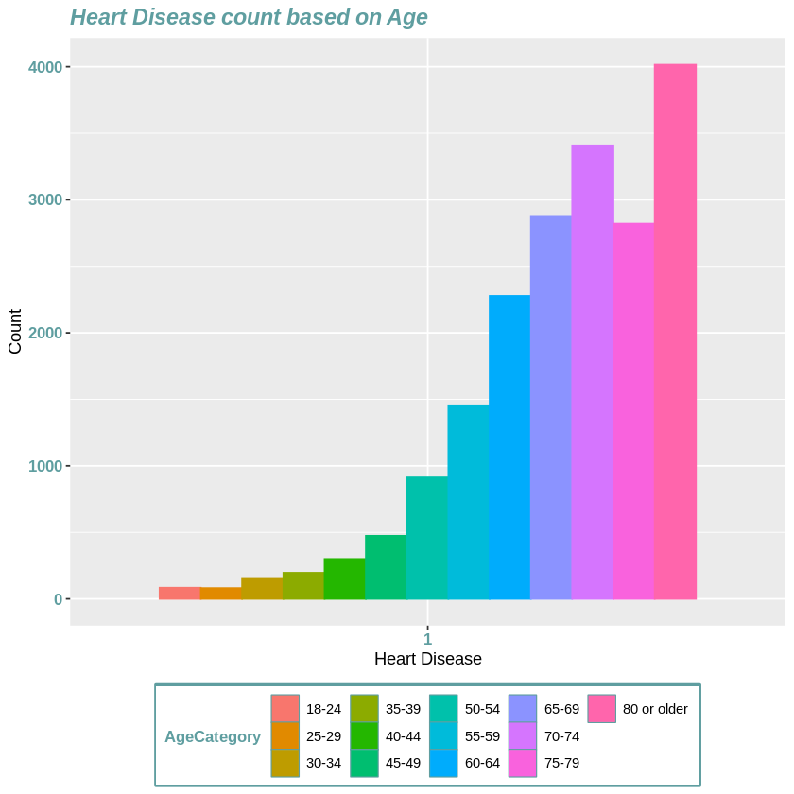
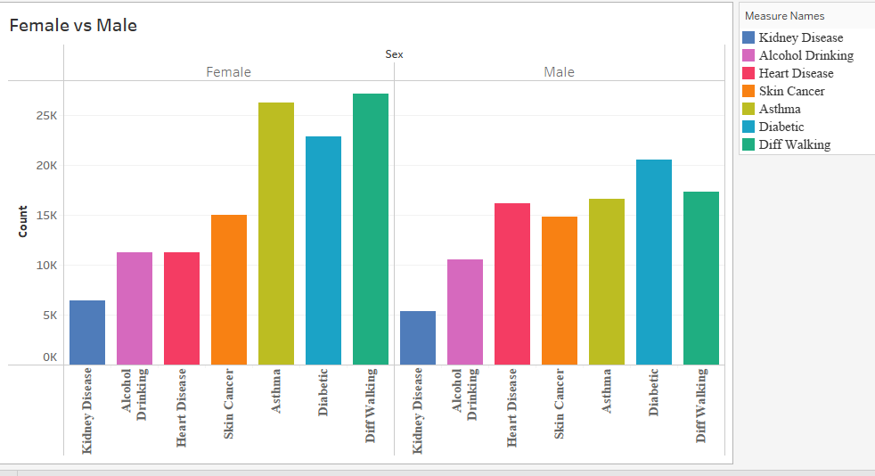
Exploratory data analysis [3 of 3]
HISTOGRAMS
Heart disease based on the Age
Comparison plot of Males and Females

Slide 8

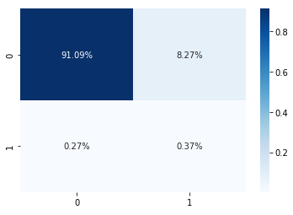
MODEL selection [1 of 4]
Logistic Regression
Simplest and best techniques for a binary classification
Large difference between null and residual deviance, and lower AIC value
Accuracy is 91.46%
A precision score is 0.9176
F1 Score of 0.9552

Slide 9
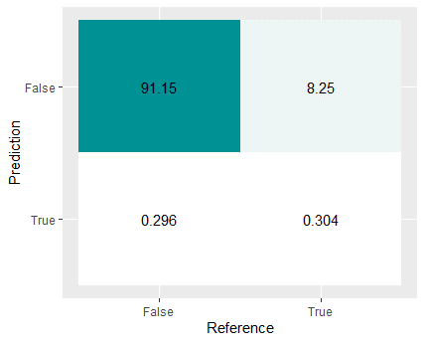
MODEL selection [2 of 4]
SVM - Support Vector Machine
A supervised machine learning algorithm for performing classification and regression analysis
Fit RBF SVM models for 100 partitions, each of them includes 1,000 observations
Average acuracy: 91.42% with a std of 0.0005525
In one partiton:
Accuracy is 91.45%
A precision score is 0.917
F1 Score of 0.9552

Slide 10
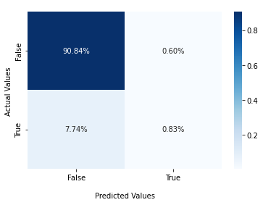
MODEL selection [3 of 4]
XGBoost
Gradient Boosting framework
Fine-tuned it with a random search to find the optimal parameter
Accuracy is 91.7%
A precision score is 0.99
F1 Score of 0.9561

Slide 11
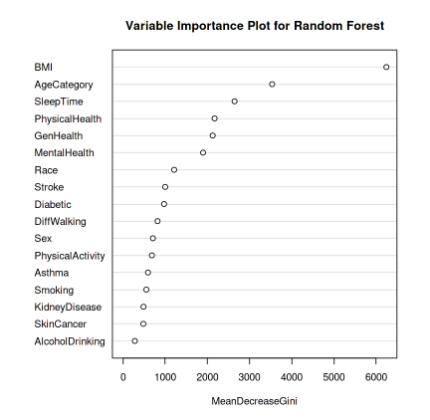
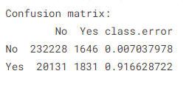
MODEL SELECTION [4 of 4]
Random Forest
Random Forest - builds and combines multiple decision trees to get more accurate predictions.
The out-of-bag cross-validation error was approximately 8.57 percent.
The accuracy rate was roughly 91.7 percent.
The precision score is 0.992.
F1 score is 0.9552.
ccuracy rate was roughly 91.7 percent after making predictions on the test dataset

Slide 12
Model comparison
Confusion matrix – Actual values vs Predicted values
Classifiers | Accuracy (%) | Precision Score | F1 Score
Logistic Regression | 91.46 | 0.9167 | 0.9552
SVM | 91.42 | 0.9170 | 0.9552
Random Forest | 91.70 | 0.9920 | 0.9552
XGBoost | 91.70 | 0.9900 | 0.9561

Slide 13


Interpretations and Recommendations
We attempted data analysis and categorization using machine learning models such as random forest, SVM, XGBoost, and logistic regression. When we analyze the findings from the table, we see that while random forest. XGBoost appears to have higher accuracy, F1-score, and precision scores are the lowest. As a result, the optimum model for this data set should be random forest, XGBoost
In the future, we would like to classify the dataset using k means and Naïve bayes models and then fit it with the best model. Moreover, we can also have fine-tuned it to be better than any other model that has been tested previously.

Slide 14
Question and answer

Slide 15

Thank you
Group 6 – PJ's Team
Bhanu Prathyusha Uppalapati
Pooja Savjibhai Viroja
Jay Haresh Vora
Lakshmi Sravya
Jie Zhang
ALY 6040 – Data Mining
Prof. Shahram Sattar
NEU, Toronto

